Slide 1

Crime Record Management System

Slide 2
Bihar is a state in the North-Eastern part of India, it is one of the states with highest crime rate in India.
According to a survey average crimes reported in Bihar for a year is 2,62,815.

Slide 3
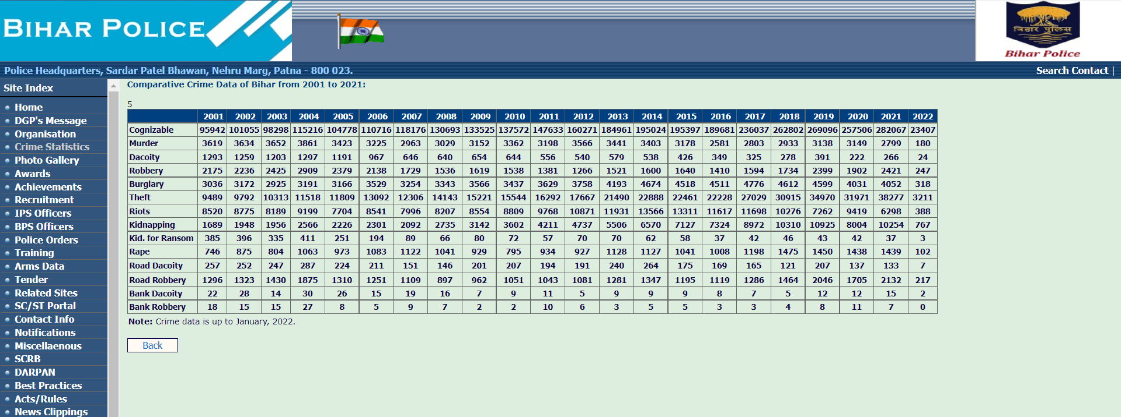
Here are the crime statistics of Bihar in the last two decades according to the Bihar Police Department :

Slide 4
The Government of Bihar wanted improve their data base system to keep track of all crime’s that occurred in the State of Bihar. This way the police department can make use of system to refer other cases from the past and assign police officers to a certain location in the future based on the crime statistics in a certain location.

Slide 5
Assumptions:
A city can have Zero- or- Many crimes reported, however a crime_id and police_id can uniquely identify a city (one-one). Police_ID represents a police station in a city.
There can be one or more Informants that can file an FIR, but an FIR can be filed by One-One Informant.
A police officer can have One-or –many Fir’s under his belt, however, an FIR can be assigned to one and only police officer.
A police officer can handle one or Many crimes, as he’s the head of the police station and the city.
.

Slide 6
A victim can be affected by one or many crimes, and vice versa
So, the M-M relationship can be avoided by using the “bridging entity” Crime_Victim
The Crime_victim table can uniquely Identify the Crime_Type table as it has composite primary keys Victim ID, Crime ID , Crime_Type_ID , all three involved. However, a crime_type can have one or many Victims affected by it.
A Crime can involve one or many suspects, and Vice Versa. Crime_Suspect table acts as a bridging entity between crime table and Suspect details table.

Slide 7
The Crime_Suspect table can uniquely Identify the Crime_Type table as it has composite primary keys Suspect ID, Crime ID , Crime_Type_ID , all three involved. However, a crime_type can have one or many Suspects involved by it.
The verdict is given by the jury based on a Particular Suspect, crime Involved in and the Sections that can be enforced under a crime committed
The suspects Motive also plays a Vital role for the verdict decision

Slide 8
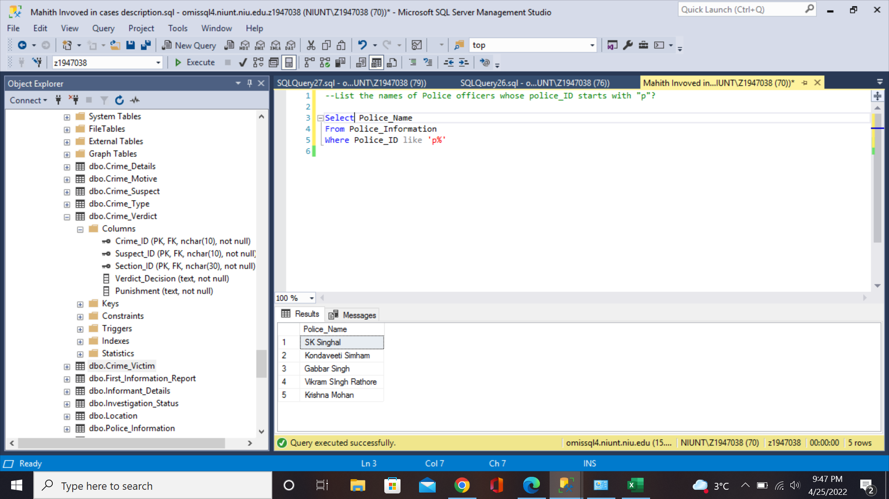
List the names of all the Police Officers whose Police_Id starts with “P” ?

Slide 9
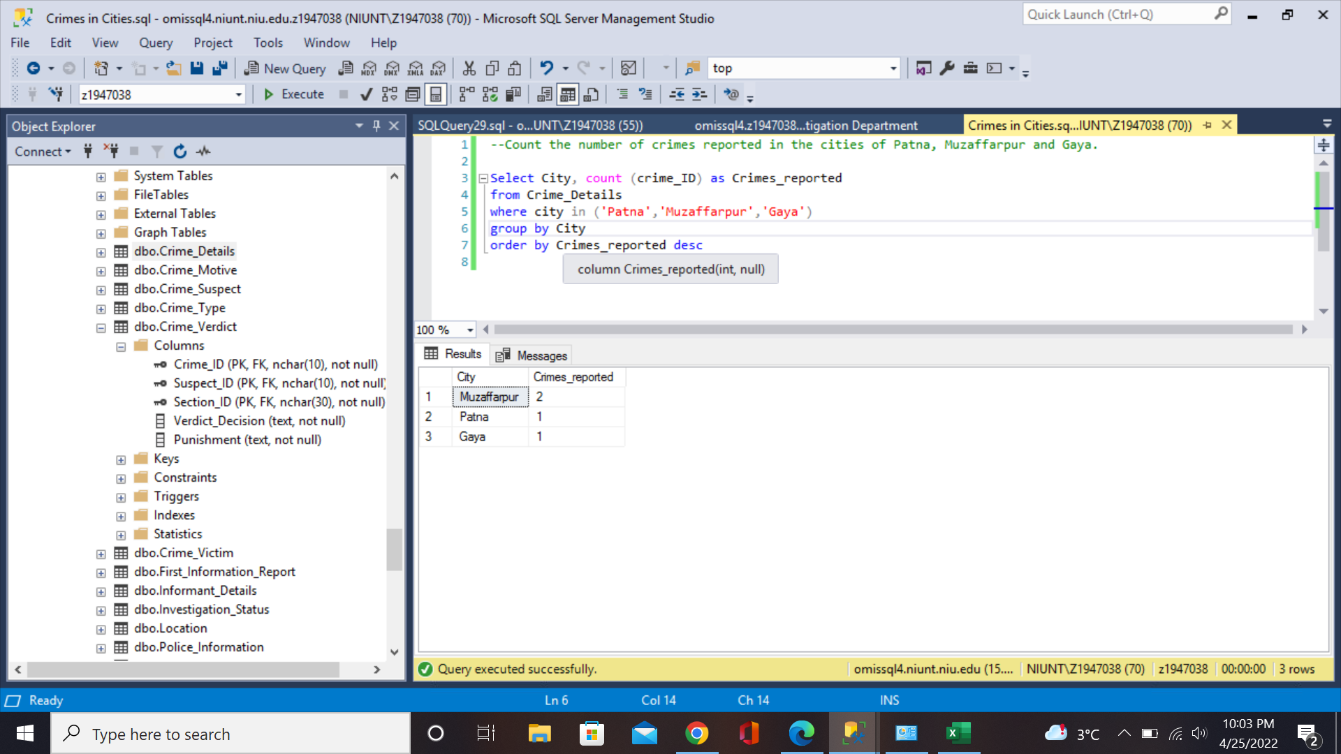
List the number of crimes reported in the States of Patna,Muzaffarpur and Gaya?

Slide 10
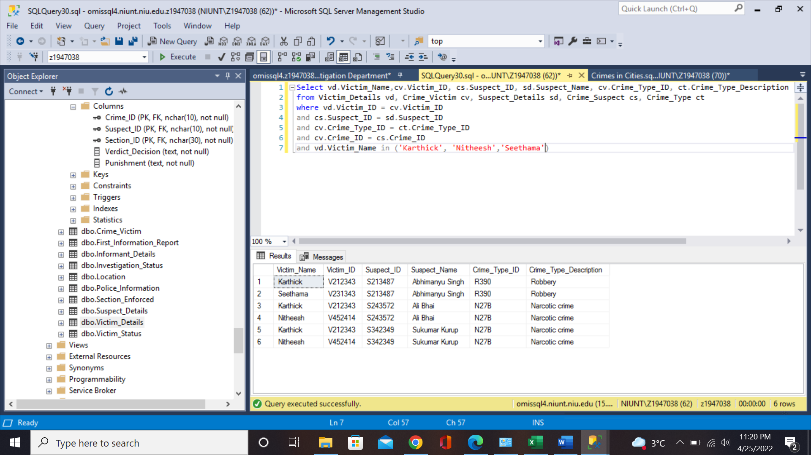

Slide 11
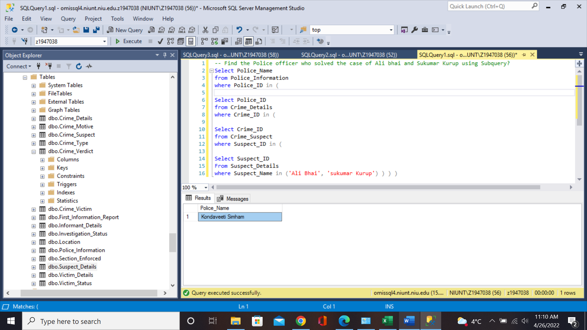
Find the Police Officer who handled the case of suspects Ali Bhai and Sukumar Kurup, using SubQuery?

Slide 12
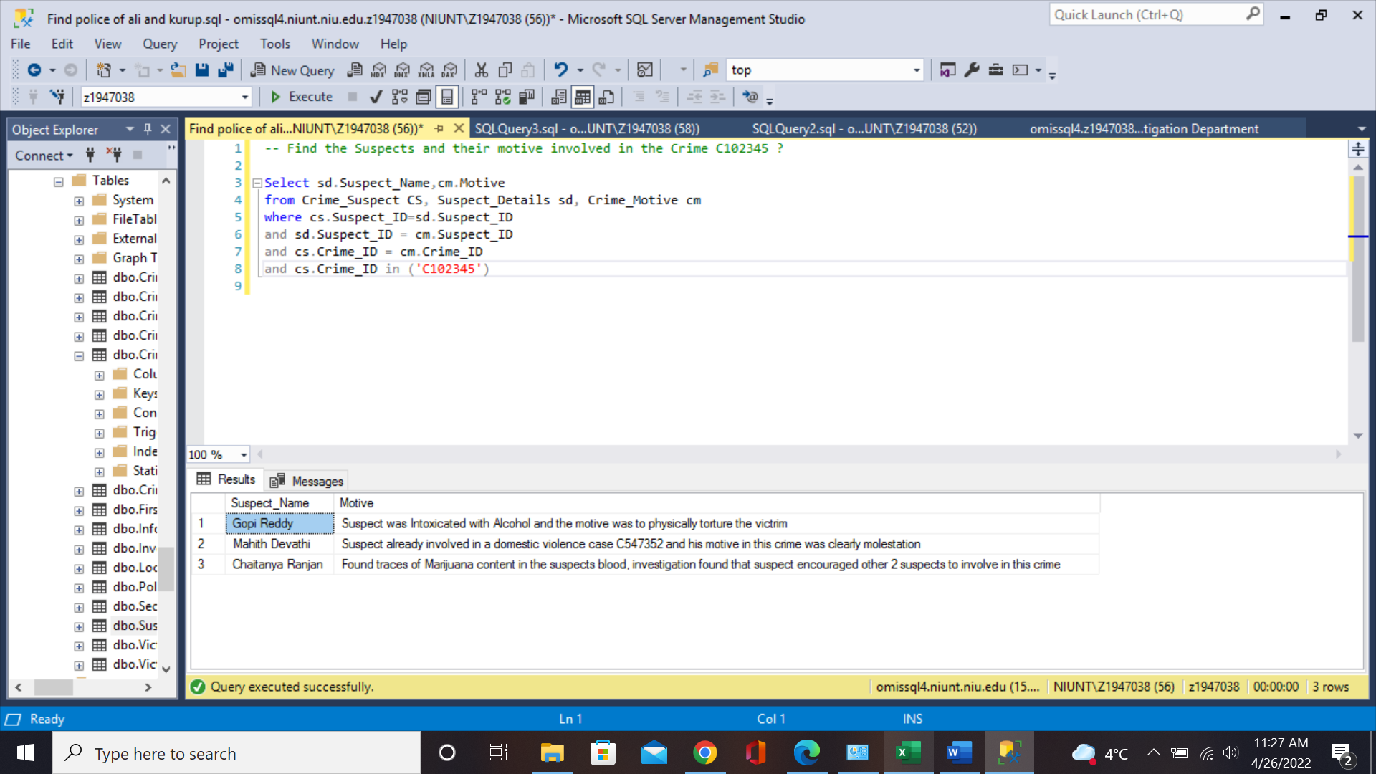
Find the Suspects and their Motive Involved in the Crime ID C102345?

Slide 13
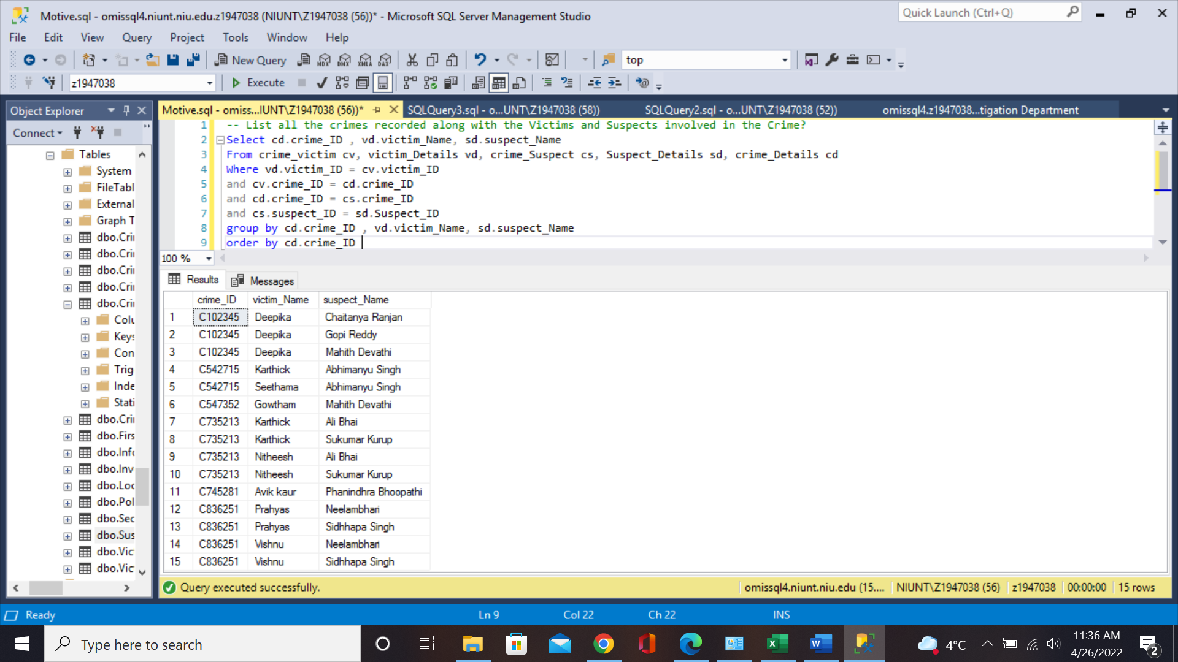
List all the Crimes recorded along with the victims and Suspects Involved in a Crime?

Slide 14
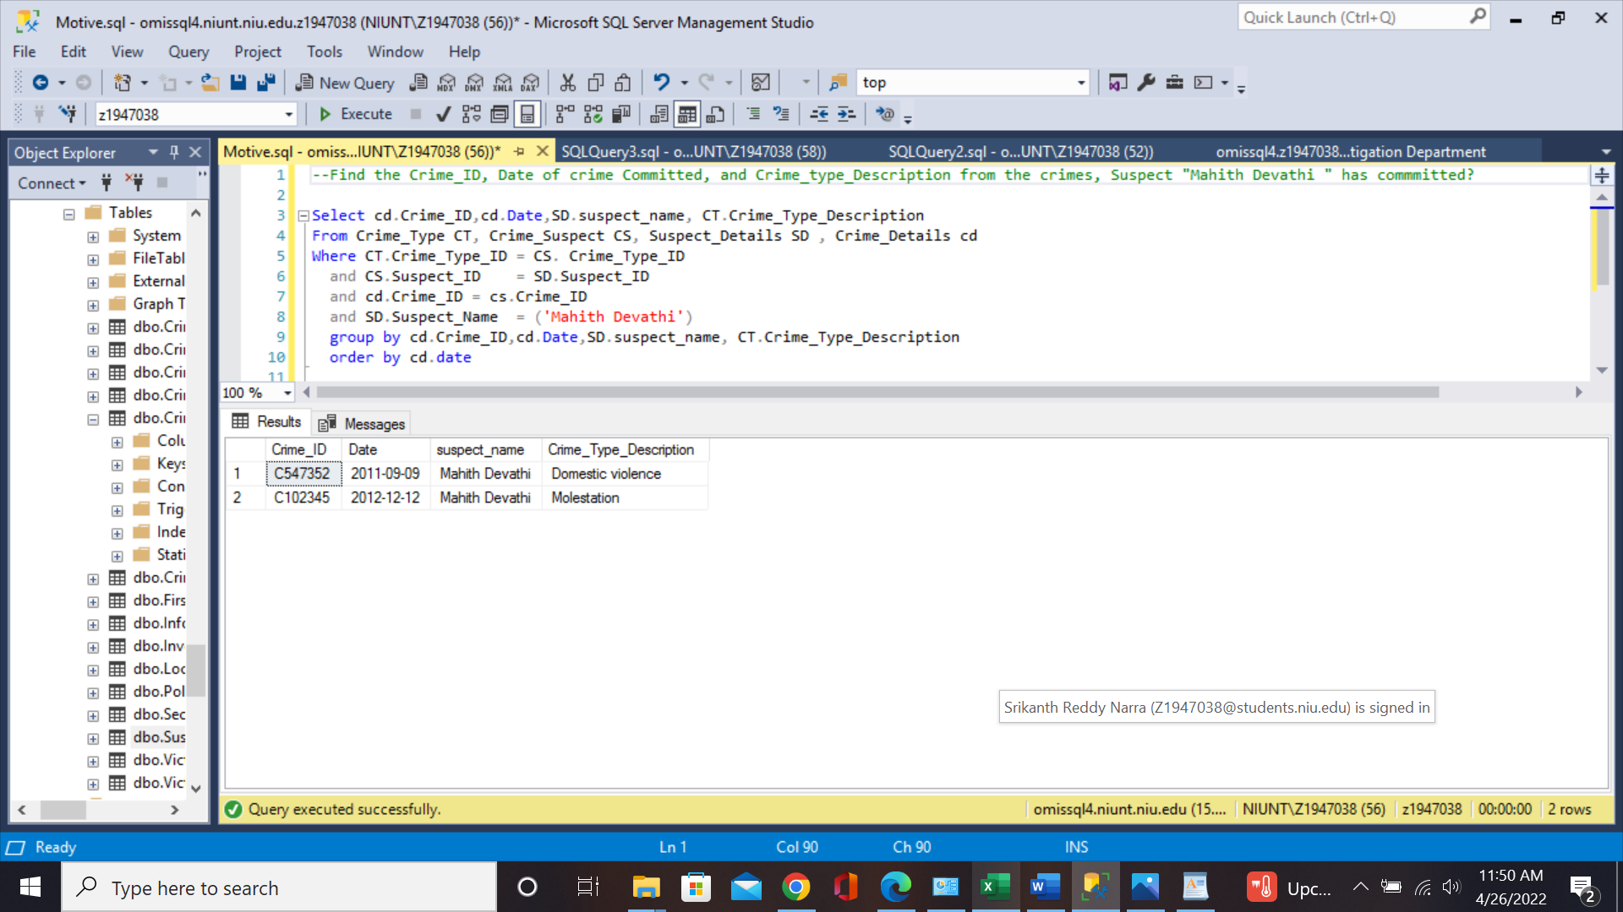
Find the Crime_ID, Date of Crime Comitted, and Crime_Type_Description from the Crime, Suspect “Mahith Devathi” was Involved in ?

Slide 15
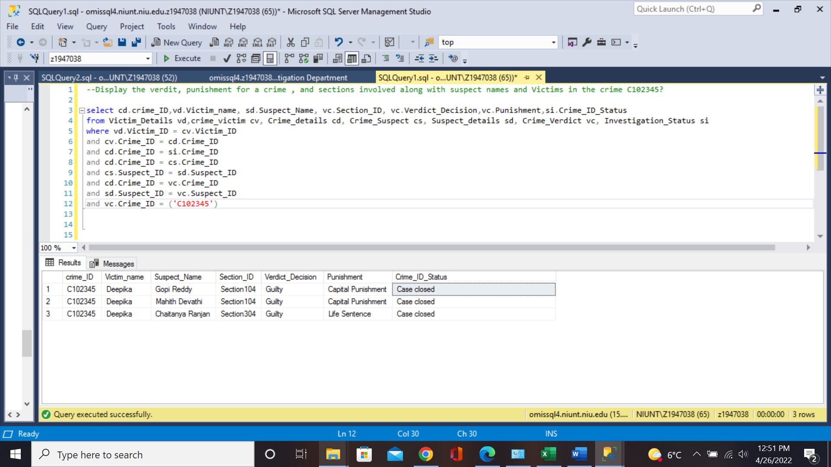
Display the Verdict, Punishment , and the sections Involved in the Crime C102345, along with the Victims and Suspects names involved in the crime?

